Slide 1




JIBEBE INTERNSHIP 2022
WEEKLY REPORT: ELIAS CHERUIYOT

Slide 2
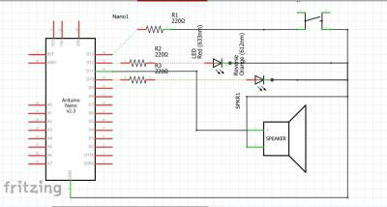


TASKS COMPLETED LAST WEEK
[#96] Eliminating inconsistency of motor speeds- The team managed to smoothen out inconsistency of speeds of the motor by introducing a 100uF capacitor on the linear acceleration circuit.
[#97]Incorporating reverse function in e-tricycle- The team managed to come up with a circuit that Incorporating reverse function. Circuit which has
1. Button for reverse direction.
2. Large LED/Industrial LED to indicate reverse is engaged.
3. Buzzer to also indicate reverse is engaged

Slide 3
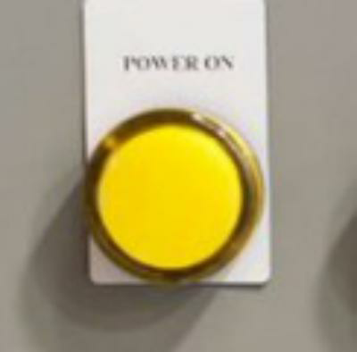
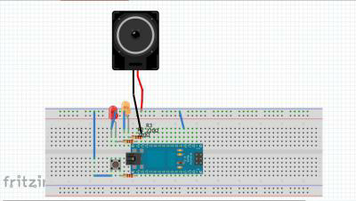
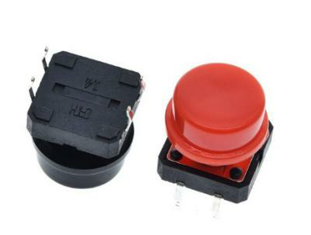

Slide 4
TASKS THIS WEEK
[#84] PCB drawing and fabrication-

Slide 5
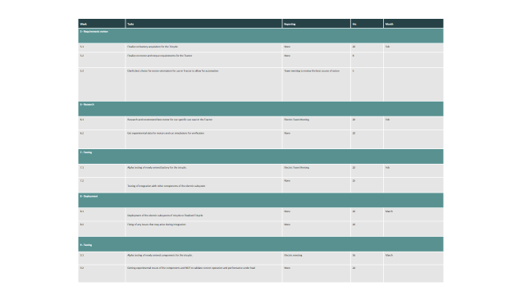

Slide 6

Thank You

